Slide 1
“Zhen vis”
Jiefei Xia
Internet of Things Final Project
https://github.com/jiefeixia/zhenvis

Slide 2
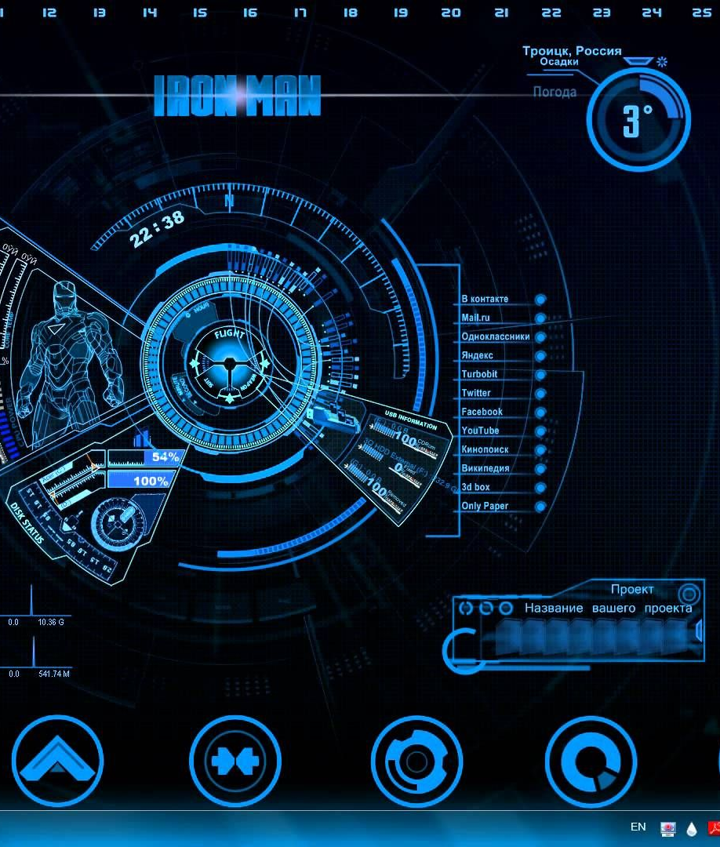
Agenda
User Story Demo
Architecture
Shopping List

Slide 3
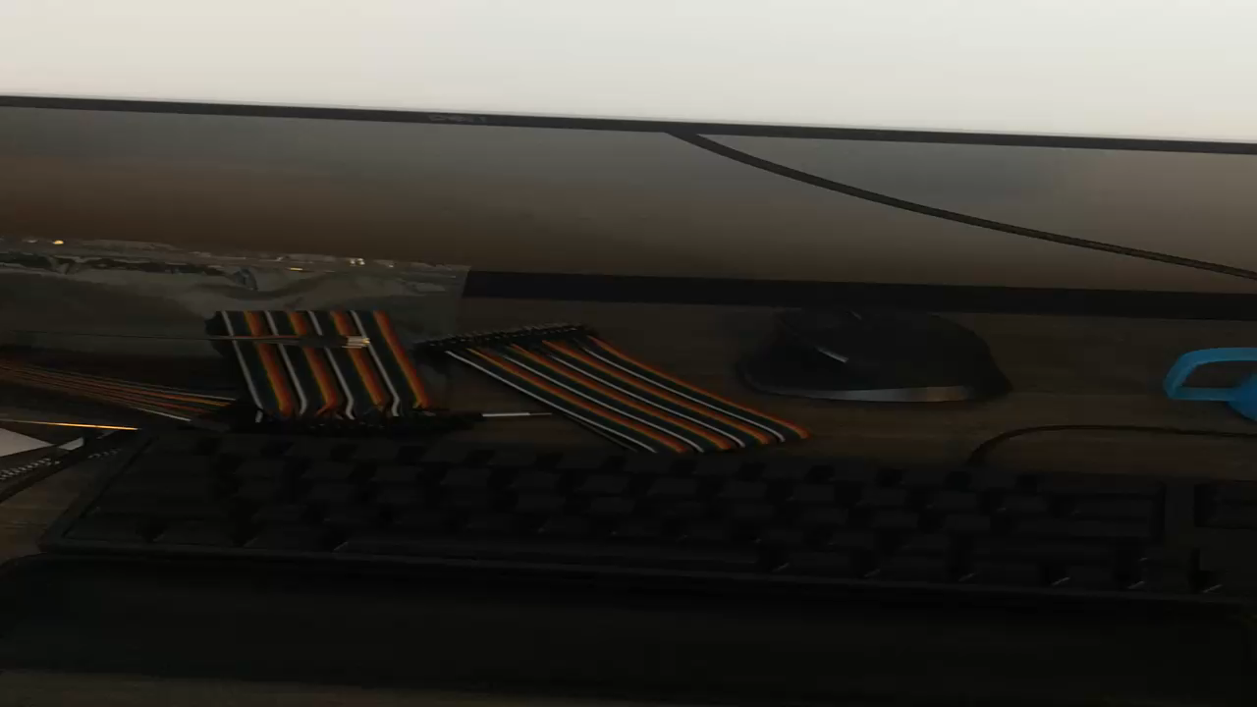
User Story Demo

Slide 4

Architecture v1
Sensor
GPIO
Local Web Browser
Raspberry Pi
(Web Server)
socketxp
USB Port Control
Water Pump
Problem: Connection Reliability

Slide 5

Architecture v2
Sensor
GPIO
Local Web Browser
AWS
MQTT Server
Web Server
Raspberry Pi
Subscribe
Publish
USB Port Control
Water Pump
Problem: Scalability

Slide 6
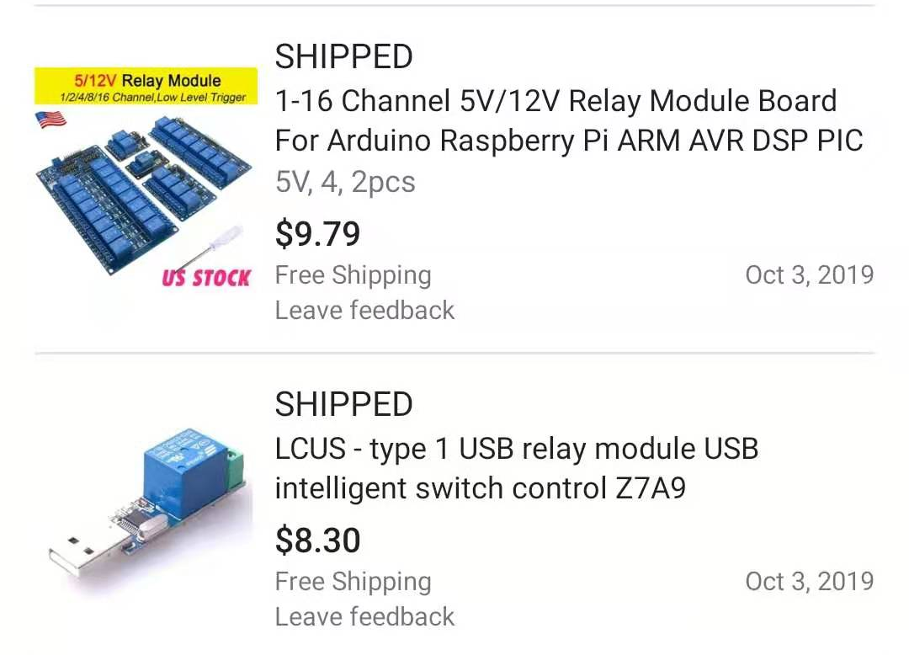
Architecture v3
Sensor
GPIO
Local Web Browser
MQTT Server on AWS
Raspberry Pi
Subscribe
Publish
GPIO
Relay
Switch
Water Pump
120v Power
Problem: Environmentally Friendly

Slide 7


Architecture v4
AI water-saving system
Sensor
GPIO
Local Web Browser
MQTT Server on AWS
Raspberry Pi
Subscribe
Publish
GPIO
Relay
Switch
Water Pump
API
OpenWeatherMap
120v Power

Slide 8
Shopping list
Raspberry Pi
Dupont Wire (female-male)
5V Water Pump
Soil Moisture Sensor
USB Relay + USB Charger

Slide 9
https://github.com/jiefeixia/zhenvis
Please star my project on GitHub!
Thank you!

